Slide 1
Analysis and concept creation
DESN2000 Workshop, Week 5
2026

Slide 2
Today
This workshop runs you through a process from data to a concept
The steps are at the bottom of this page
Why a process like this? Its steps can be traced afterwards, and you can explain your decisions
5 min
15 min
15 min
10 min
20 min
15 min
20 min
5 min
Intro
Organise data
Analysis
Value proposition
Ideation
Select concept
Subsystems
Wrap-up
All
Team
Team
Team
Team
Team
Team
All

Slide 3
Organize data
Over the last few weeks, you have collected a wealth of data, but it is probably still in bits and pieces: it is data, not information
In next 10 min
Each team member should tell what they have collected, and share it
Use A4s, post-its, or a digital platform like Miro, Canva or OneNote to map what you have
Also write down notes about what you think is missing
5 min
10 min
15 min
15 min
20 min
15 min
20 min
5 min
Intro
Organise data
Analysis
Value proposition
Ideation
Select concept
Subsystems
Wrap-up
All
Team
Team
Team
Team
Team
Team
All

Slide 4
Analysis 1/2
Next step is analysis, or steps that turn your data into an informative signals
In your team, please
First, each team member runs through his/her bit of data and tells what is interesting in them
**Keep notes about these potential observations for each person, even if it is the same!
Second, compare these observations to see which observations converge, and which ones remain isolated/random observations
5 min
15 min
15 min
10 min
20 min
15 min
20 min
5 min
Intro
Organise data
Analysis
Value proposition
Ideation
Select concept
Subsystems
Wrap-up
All
Team
Team
Team
Team
Team
Team
All

Slide 5
Analysis 2/2
Third, when you have identified areas of convergence, place them in front of you to analyse variation within these areas
Is there variation?
If there is, is it significant enough to lead to a new category?
5 min
15 min
15 min
10 min
20 min
15 min
20 min
5 min
Intro
Organise data
Analysis
Value proposition
Ideation
Select concept
Subsystems
Wrap-up
All
Team
Team
Team
Team
Team
Team
All

Slide 6
Value proposition
Based on your findings, draft a value proposition statement followed by a concept generation session. This can be a flipped and more specific version of your problem definition!
The proposition should consider:
What does your solution do that creates the most value for your user? How does it relieve their pains or create gains for them in other ways?
What does your solution do that others don’t? How does your solution differentiate… what makes it special? Consider other existing solutions … or what the other teams in this course are developing
5 min
15 min
15 min
10 min
20 min
15 min
20 min
5 min
Intro
Organise data
Analysis
Value proposition
Ideation
Select concept
Subsystems
Wrap-up
All
Team
Team
Team
Team
Team
Team
All

Slide 7
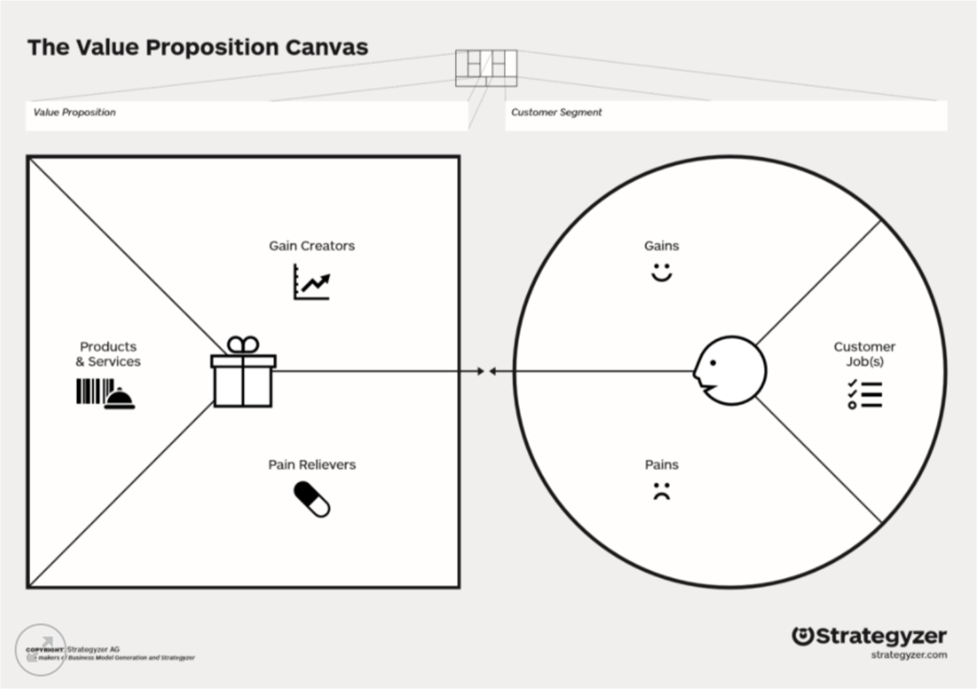
Tools like “the value proposition canvas” may help to structure the process of generating the proposition
From User Scenarios & Journey Mapping
Strategyzer’s Value Proposition Canvas:
•Manual (Pdf)
•Explained (Youtube)
•Blank (Pdf)
From broad consideration of what could help your users
5 min
15 min
15 min
10 min
20 min
15 min
20 min
5 min
Intro
Organise data
Analysis
Value proposition
Ideation
Select concept
Subsystems
Wrap-up
All
Team
Team
Team
Team
Team
Team
All

Slide 8
Ideation 1/1
Select an ideation technique from the lecture
Appoint a facilitator: keeps the pace, motivates the team
Keep pressure: don’t stare at a blank canvas for long
Focus on quantity, not quality
No criticism at this stage: silly ideas are fine
Keep your Value Proposition at the centre of your creative session
Keep in mind your research findings and what you know so far about your stakeholders
Read you UVP statement every 10 minutes to make sure you don’t lose the direction!
Document the outcomes
5 min
15 min
15 min
10 min
20 min
15 min
20 min
5 min
Intro
Organise data
Analysis
Value proposition
Ideation
Select concept
Subsystems
Wrap-up
All
Team
Team
Team
Team
Team
Team
All

Slide 9
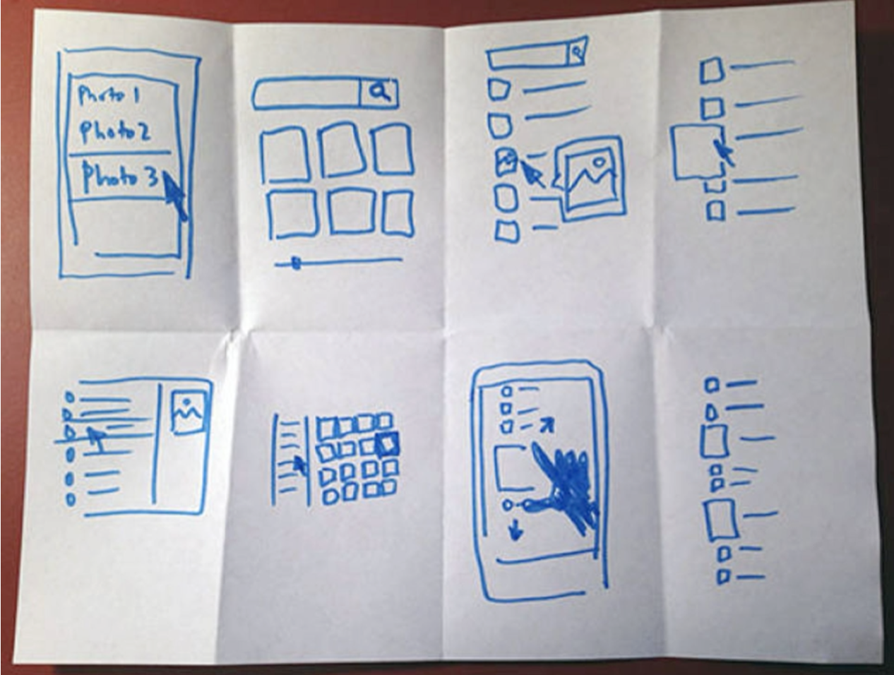
Ideation 1/2
Take the value proposition
Have something to write and draw on (whiteboard, A4, post-its)
Start a timer for 5 minutes
Use a well-known technique
Crazy 8s: take an A4, fold it to get 8 rectangles, and fill each rectangle with an idea (right)
5 min
15 min
15 min
10 min
20 min
15 min
20 min
5 min
Intro
Organise data
Analysis
Value proposition
Ideation
Select concept
Subsystems
Wrap-up
All
Team
Team
Team
Team
Team
Team
All

Slide 10
Concept selection
Select a concept selection technique from the next slide, your own research or from DESN1000
Reflect on the ideas collected so far
What areas (kind of ideas/solutions/challenges) are covered well?
Which ideas are answering better to your problem and the needs of your stakeholders?
Think of alternative solutions (less is more!)
If a challenge feels too big, subdivide and solve the parts
It may help to pin up all output on a wall, lay it out on a table, etc. to get a good overview
5 min
15 min
15 min
10 min
20 min
15 min
20 min
5 min
Intro
Organise data
Analysis
Value proposition
Ideation
Select concept
Subsystems
Wrap-up
All
Team
Team
Team
Team
Team
Team
All

Slide 11
Concept selection 1/2
Again, use a well-known technique to select your concept
For example, Clive Dym’s Engineering Design (remember DESN1000?) has descriptions of
Decision Matrix – score options against weighted criteria
Pairwise Comparison – score options against each other
5 min
15 min
15 min
10 min
20 min
15 min
20 min
5 min
Intro
Organise data
Analysis
Value proposition
Ideation
Select concept
Subsystems
Wrap-up
All
Team
Team
Team
Team
Team
Team
All

Slide 12
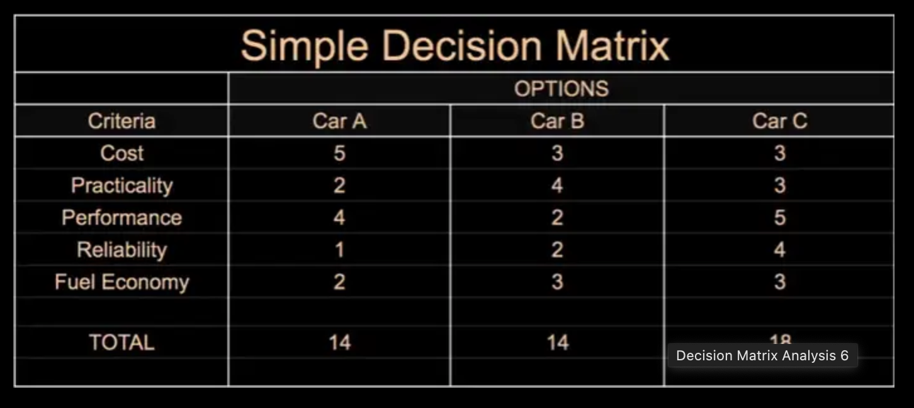
Concept selection 2/2
Simple version
Create a list of criteria (rows)
Concepts as columns
Give points from 1-5 to each concept
5 min
15 min
15 min
10 min
20 min
15 min
20 min
5 min
Intro
Organise data
Analysis
Value proposition
Ideation
Select concept
Subsystems
Wrap-up
All
Team
Team
Team
Team
Team
Team
All

Slide 13

Sketching subsystems
As soon as you have a concept, break it into subsystems to start mapping solutions
Sketch briefly the subsystems and their connections
Discuss briefly materials and technical enablers (subcomponents of subsystems)
This starts to create a map of potential tasks ahead and helps in scoping
5 min
15 min
15 min
10 min
20 min
15 min
20 min
5 min
Intro
Organise data
Analysis
Value proposition
Ideation
Select concept
Subsystems
Wrap-up
All
Team
Team
Team
Team
Team
Team
All

Slide 14
Wrap-up
•Brief reflection
Each group to share their progress, use of ideation methods
•Looking ahead
Next step is: go ahead with the best solution/s
5 min
15 min
15 min
10 min
20 min
15 min
20 min
5 min
Intro
Organise data
Analysis
Value proposition
Ideation
Select concept
Subsystems
Wrap-up
All
Team
Team
Team
Team
Team
Team
All

